Slide 1
Bill Payment Success Rate Drop Analysis
ROOT CAUSE ANALYSIS
E-Wallet product analytics · Jul 1 – Aug 31, 2023
32,122 transactions · 49,675 sessions · 435,658 app events · 1,500 users
Notes:
This deck explains why the Billing success rate dropped after July 28, 2023, and what to fix first. Data: 32,122 transactions, 49,675 sessions, 435,658 app events and 1,500 users (Jul 1 - Aug 31, 2023).
How to read it: Before = Jul 1-27, After = Jul 28-Aug 31 (the day of app release v3.9.6). Dates come from the sessions table (transaction_date is shifted by up to 25 hours on about 15% of rows). Every number comes from the dataset. Statements about mechanisms are inferences and are marked 'most likely': the data has no server or deploy logs.

Slide 2
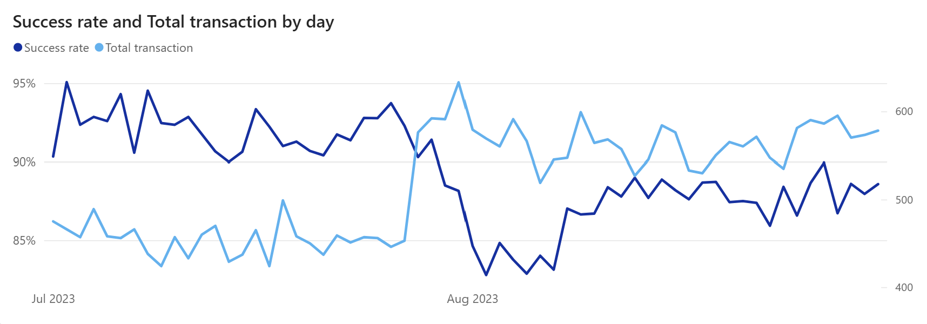
Success rate fell from 92.1% to 87.3% after July 28
OVERVIEW
Before · Jul 1–27
92.1%
12,270 transactions
v3.9.6 · Jul 28
After · Jul 28–Aug 31
87.3%
19,852 transactions
Change
−4.8 pp
after vs before
Every day after July 28 stayed below the old average of 92.1% (the best day reached 91.4%). The drop starts on the same day as app release v3.9.6.
Notes:
Overall success rate fell from 92.1% to 87.3% after July 28 (-4.8 pp). Every day after July 28 stayed below the old average (best day 91.4%; the worst day before was 90.0%). The date matches app release v3.9.6.
Deeper look: the fall is a step on one day, not a slow decline. In incident work the first question is 'what changed?': the Google SRE book reports that roughly 70% of outages are due to changes in a live system. Transactions per day rose from 454 to 567 (+25%), so the drop reached more people. A blended rate hides local problems: the next slide shows that one product, Billing, carries most of it.

Slide 3
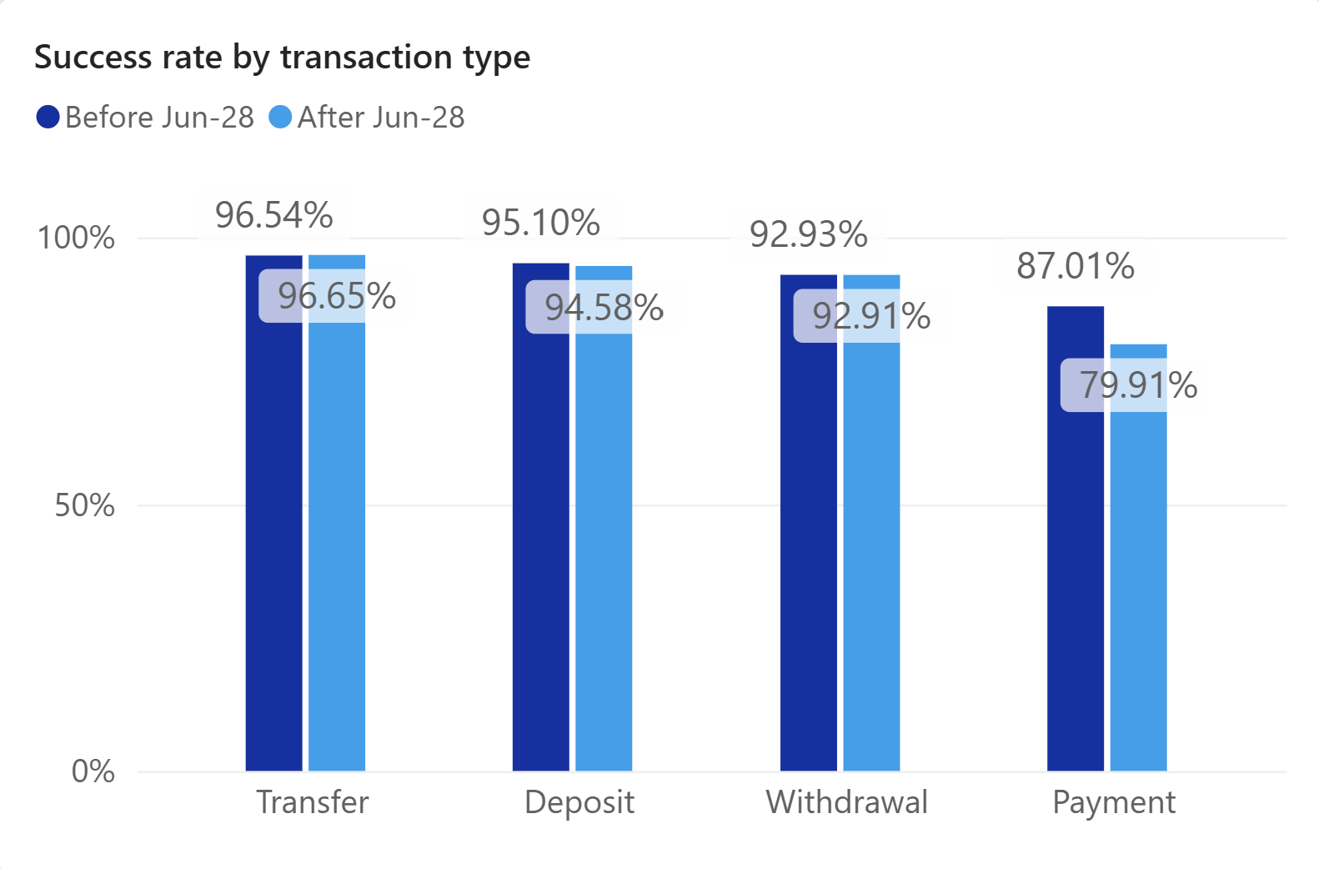
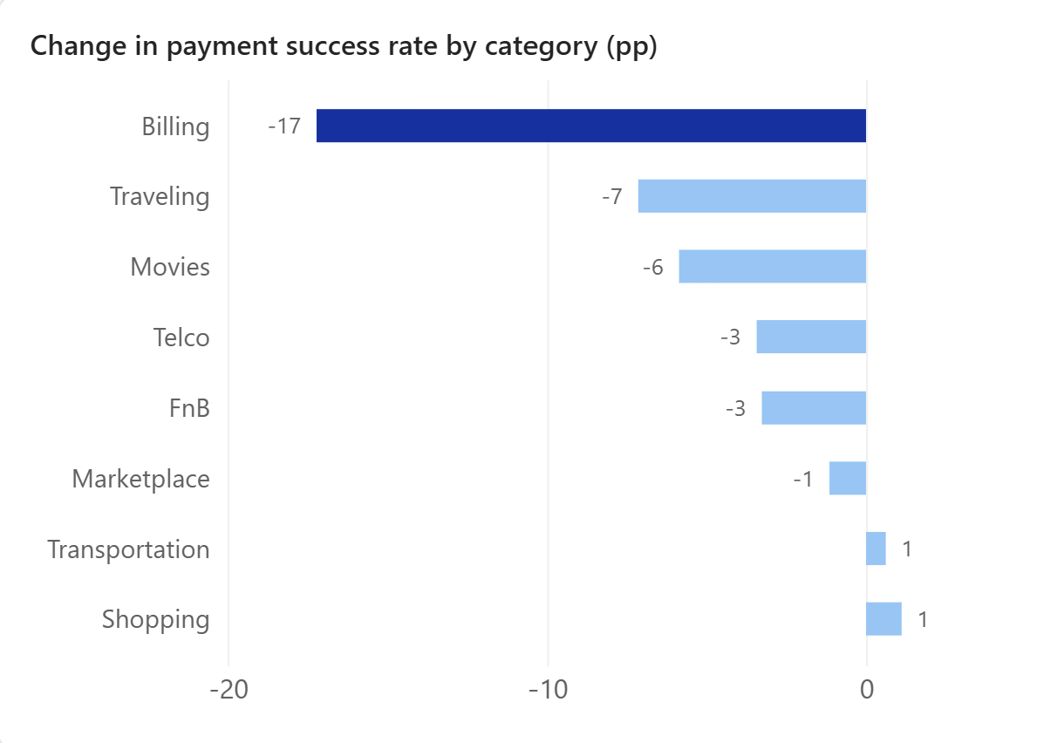
Payments drove the drop, and Billing fell the most
OVERVIEW
Billing is 20.5% of transactions after Jul 28 but 43.9% of all failed transactions (it was 16.9% before). The rest of this report focuses on Billing.
Notes:
Transfers, deposits and withdrawals did not change. Payments fell from 87.0% to 79.9%. Inside payments, Billing fell the most (-17.2 pp). Billing is 20.5% of transactions after Jul 28 but 43.9% of all failed transactions (16.9% before).
Deeper look: Billing's own rate fall explains 73% of the overall -4.8 pp (-3.5 pp). The other categories moved by -7 pp (Traveling), -6 (Movies), -3 (Telco, FnB) and -1 to +1 (the rest). With 139-268 payments in the smaller categories, two-proportion z-tests stay below 2 (normal noise), while Billing's change has z = 14. Merchant payments use the same banks, cards and OTP/3DS and stayed at 86.6% -> 86.6% (1,952 and 4,605 payments). They are a control group: whatever broke is specific to the bill flow. Difference between the two flows: -17.3 pp.

Slide 4
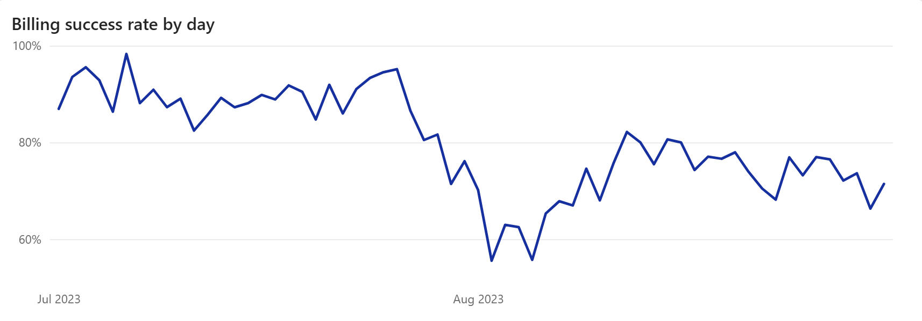
Billing success rate broke on July 28 and never came back
INSIGHT
v3.9.6
v3.9.7 · API v3.0
v3.9.8
v3.9.9 · emergency fix
Average fell from 89.9% to 72.7%. The best day after Jul 28 (82.2%) was lower than the worst day before (82.5%), and three fix releases did not change that.
Notes:
Billing was stable around 90% for four weeks, then broke on July 28. Lowest day: 55.6% on Aug 2. The best day after Jul 28 was 82.2%, lower than the worst day before (82.5%), so the two periods do not overlap (z = 14). It did not recover after three fix releases.
Deeper look: bill payments per day rose from 60 to 116 (bill users per day 59 -> 112) on the day v3.9.6 shipped. The release notes added reward points for every bill payment and bill scheduling, which may explain the jump (inference). More attempts met a broken step, so successful bills per day still rose (54 -> 85). A dashboard of counts can look healthy while the success rate collapses. Monitor the success rate per flow (the symptom), not only totals. Hypothesis H1 (API time-outs increase at peak traffic) is tested by trend analysis: this slide shows when the rate broke; the peak-traffic test is on slide 8. Google SRE book: 'Your monitoring system should address two questions: what's broken, and why?'

Slide 5
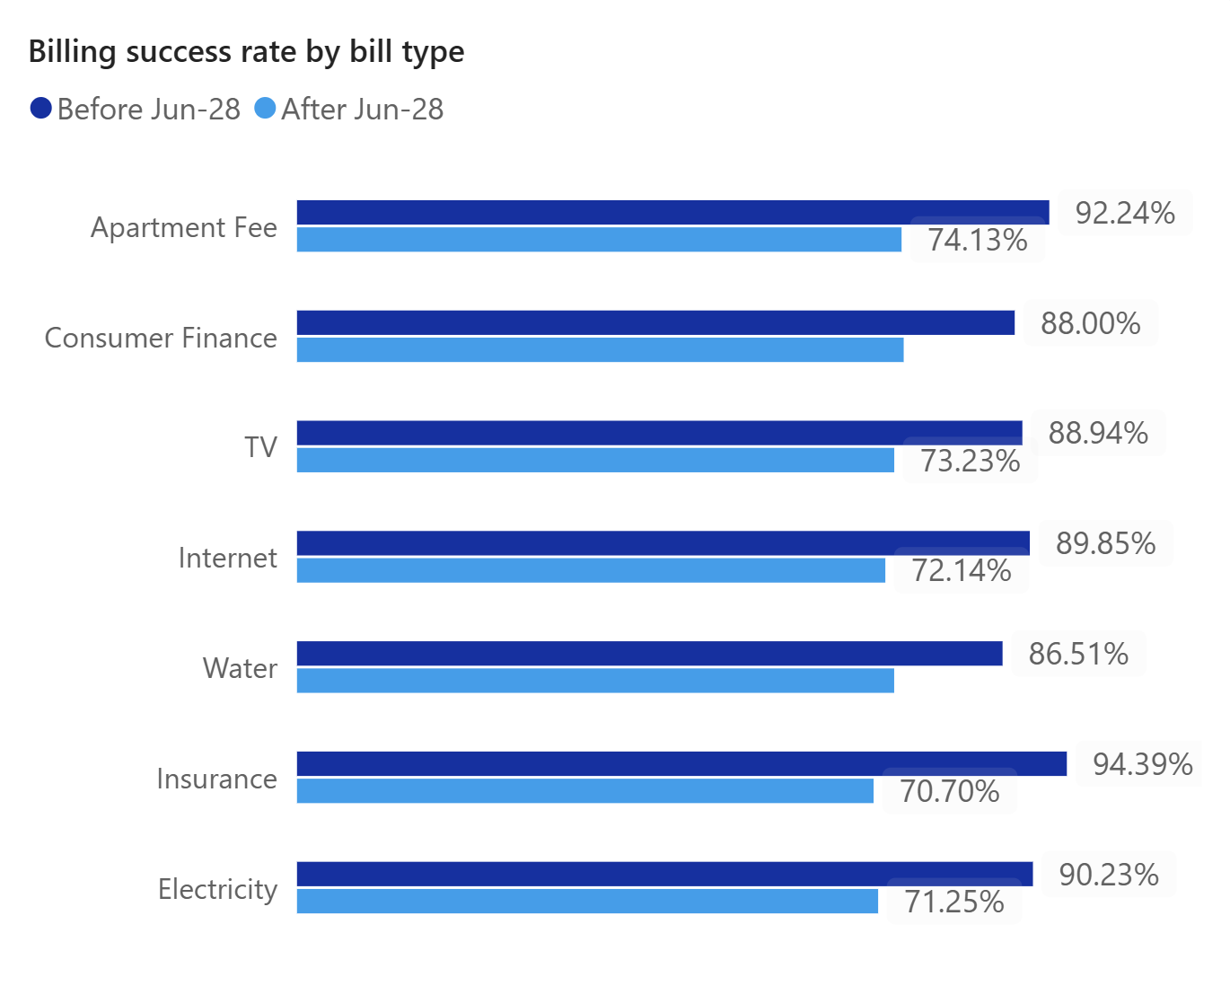
Every bill type and every user group fell by about the same amount
INSIGHT
Change by user and payment group
Group | Change | Rate after
Platform (Android, iOS, Web) | −15.1 / −19.0 / −18.0 pp | 73.4% / 71.7% / 73.0%
Payment method (credit, debit, bank, local card, wallet) | −15.3 / −20.8 / −16.4 / −19.5 / −16.8 pp | 74.2% / 72.3% / 72.8% / 69.0% / 71.6%
Age group (18-24, 25-34, 35-44, 45+) | −17.6 / −17.0 / −18.0 / −15.9 pp | 73.7% / 72.4% / 72.2% / 72.8%
Loyalty tier (bronze, silver, gold, platinum) | −17.7 / −15.5 / −18.3 / −19.6 pp | 72.6% / 72.9% / 72.5% / 73.2%
Network quality (excellent, good, fair, poor) | −18.4 / −14.9 / −16.4 / −20.2 pp | 73.0% / 73.8% / 71.8% / 71.7%
First-time vs repeat bill payer | −18.1 / −15.7 pp | 72.8% / 72.7%
All groups ended at about 71–74% (local cards 69%, only 29 payments), so the cause is not one biller, bank, device or user type. Every bill payment goes through it.
Notes:
Every bill type and user group fell by about the same amount (-13 to -24 pp) and ended at 71-74% (the one exception, local cards at 69%, has only 29 payments). So it is not one biller, bank, device or user type.
Deeper look: the spread across bill types was 7.9 pp before (86.5-94.4%) and 3.7 pp after (70.7-74.4%). When different groups converge on one level, a shared step is capping all of them. Insurance fell most (-23.7 pp) only because it started highest. Authentication route: bills that went through 3DS (mostly credit and debit cards) fell from 90.4% to 74.1%; bills that went through OTP (wallet, linked bank, and about one card payment in five) fell from 90.3% to 72.6%. Both routes fell by 16-18 pp, so the problem is not tied to one payment method. First-time vs repeat bill payers: 90.9% -> 72.8% and 88.4% -> 72.7%. A total per field always shows the same 89.9% -> 72.7%, because every field is a split of the same 5,700 bills. Only the sub-groups can show a difference, and they show none. Hypotheses (comparative and user segment analysis): H2 (a shared issue lowers success across versions, devices, categories) partly supported: every bill type, device and user group fell, but other payment categories did not, so the shared issue sits in the bill flow. H5 (old devices or OS versions) not supported: phones fell 17.0 pp and tablets 18.0 pp, and OS versions 10 to 16 each fell 14-19 pp. H6 (first-time users or new accounts) not supported: first-time payers fell like repeat payers, and accounts under 90 days old fell from 86.1% to 70.4%, like older accounts (all 10 cities also fell by 14-24 pp). H9 (issuer banks) not supported as the cause: cards, banks and wallets fell alike, merchant payments through the same banks stayed flat, and issuing-bank errors rose only +0.9 pp (0.5% to 1.4% of bill payments). Table fix: the duplicated 'Payment method' row was replaced by the missing 'First-time vs repeat' row.

Slide 6
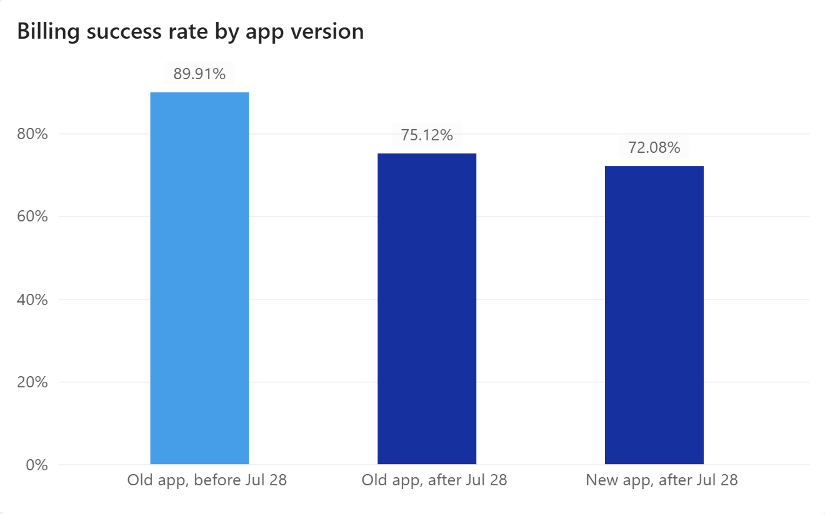
Users who did not update the app failed too, so the change was likely server-side
INSIGHT
A bug only inside the new app would not hurt users on old versions, but they fell 14.8 pp. So the main change most likely shipped on the server side with v3.9.6: 83% of the new-app drop (14.8 of 17.8 pp) also hit old-app users.
Notes:
Users who did not update the app fell too (89.9% to 75.1%), almost as much as new-app users (72.1%). A bug only in the app would not do that, so the main change was most likely on the server, released together with v3.9.6. About 83% of the new-app drop (14.8 of 17.8 pp) also hit old-app users.
Deeper look: the app added a small, short extra dip. In week 1 (Jul 28-Aug 4) new-app users did worse than old-app users on the same days (67.1% on 598 bills vs 76.3% on 515 bills; vs 77.6% if only v3.9.5 is used). In the later phases the gap is about 1 pp or less (-1.0, +0.9, -0.9 pp; z below 0.3). Over the whole period new vs old is -3.0 pp and not significant (z = 1.8). Why old apps are hit too: apps call the same backend through versioned APIs, so one server-side change reaches every version at once, and nothing is overwritten on the phone. This is an inference: the dataset has no server logs. Hypothesis: H2 (a shared issue lowers success across app versions, devices, categories) partly supported: old and new app versions both fell, but other payment categories did not, so the shared issue sits in the bill flow.

Slide 7
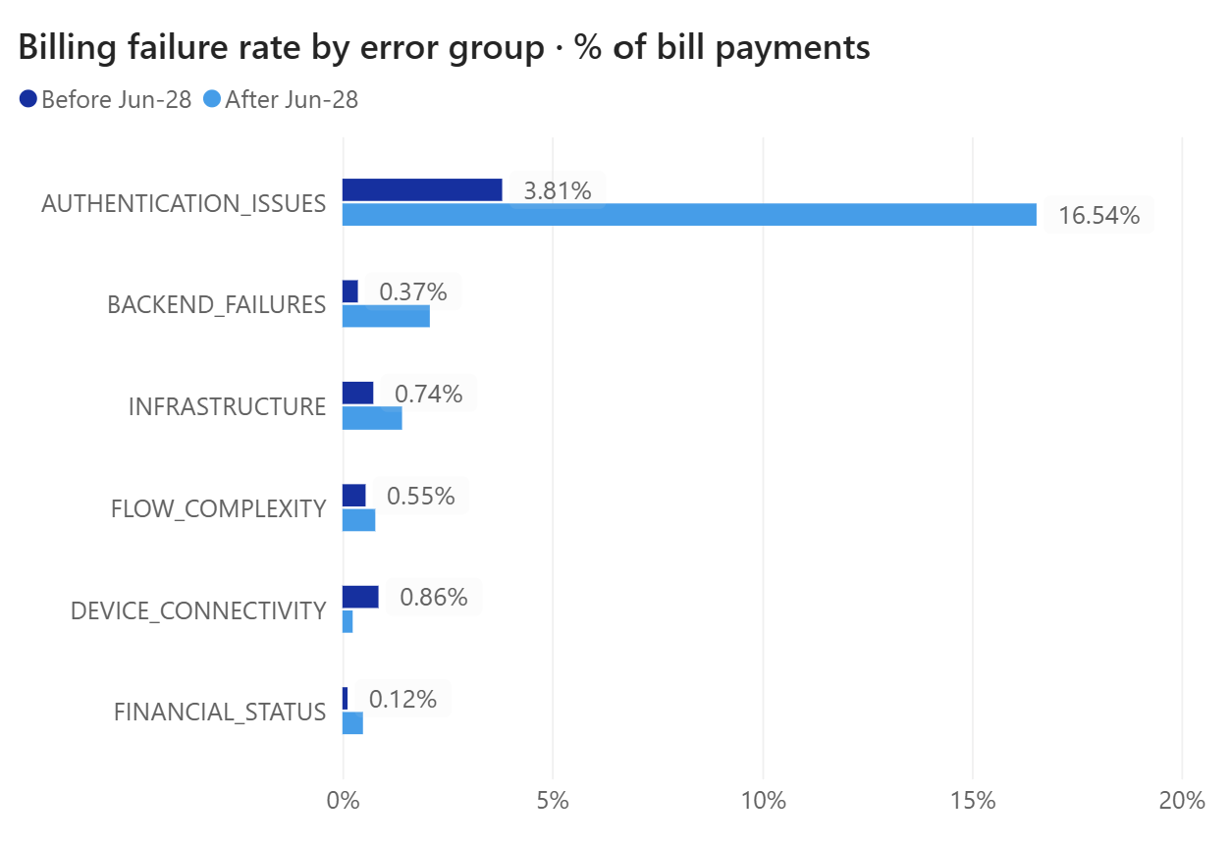
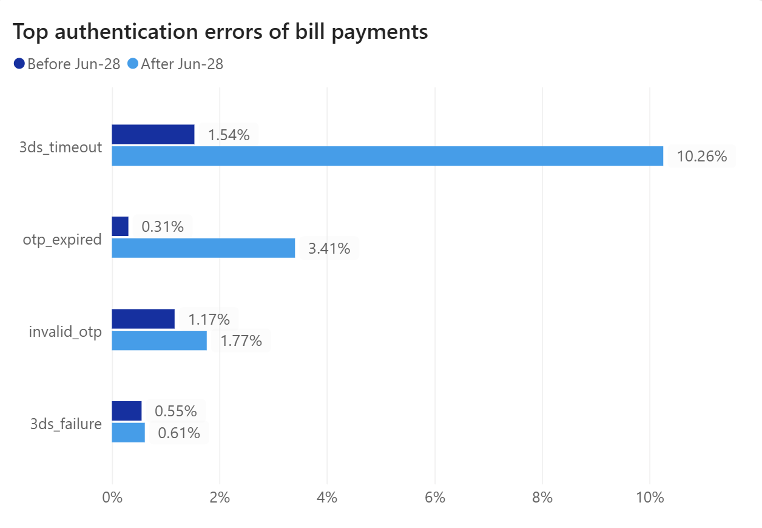
Authentication errors explain about three quarters of the drop
INSIGHT
Failure rate rose from 10.1% to 27.3% (+17.2 pp). Authentication alone added +12.7 pp (74%), system errors +2.8 pp (17%), all other groups +1.6 pp. The two biggest errors are about time: 3DS time-out and expired OTP (+11.8 pp, 69% of the rise).
Notes:
Bill payment failure rate rose from 10.1% to 27.3%. Authentication errors explain +12.7 pp of the +17.2 pp (74%); system errors (backend, infrastructure, gateway, integration) +2.8 pp (17%); all other groups together +1.6 pp. The two biggest errors are 3ds_timeout (1.54% -> 10.26%) and otp_expired (0.31% -> 3.41%): +11.8 pp, 69% of the rise.
Deeper look. (1) Tail, not average: the median 3DS wait went from 12 s to 13 s, but p90 went from 18 s to 45 s and p95 from 20 s to 60 s; for OTP the p99 went from 30 s to 110 s. Averages hide slow requests, so track p95/p99 (Google SRE book, 'Worrying about your tail'). (2) Hard cut-off: when 3DS finishes within 25 s, 86% succeed (n = 1,907); above 25 s only 1 of 178 did. For OTP, 0 of 99 succeeded above 30 s. Successful payments are as fast as before (3DS p95 = 18 s in both periods); what changed is how many payments miss the cut-off: 3DS over 25 s went from 1.9% to 11.1% of 3DS payments (582 before, 1,503 after), and OTP over 30 s from 0.2% to 3.8% of OTP payments (1,036 before, 2,537 after). (3) Two or more authentication tries in one payment: 4.4% -> 16.1% of bills, and none of the 726 succeeded (0 of 72 even in July). Payments with a single try also got worse (94.1% -> 86.6%). Roughly 60% of the 17.2 pp fall comes from more payments needing 2+ tries and roughly 40% from lower success among single-try payments (the split moves a few points with the order of the calculation). Retries that never work point to a broken retry path (for example no fresh OTP or 3DS session on a second try): worth checking.(4) Both routes broke (3DS 90.4% -> 74.1%, OTP 90.3% -> 72.6%), so look at what they share. (5) Error-tree trap: all 736 authentication failures sit under L1 'USER_FACTORS'. After Jul 28 that L1 holds 725 of the 1,112 failed bills (65%), and 674 of them are authentication errors. Reading only L1 would blame users, although the same users did not change. (6) Industry norms: the EMV 3DS SDK sets a challenge time-out of at least 5 minutes; OWASP ASVS V2.7.2 (NIST ref. 5.1.3.2) expires out-of-band codes after 10 minutes. The limits seen here are 25-30 seconds. Hypotheses (funnel and error comparative analysis): H3 (drop-off at a process step) partly supported: payments are lost at one step of the journey, authentication, but the data points to a slower step and short time limits, not to the screen design. H4 (users wait for feedback or drop off) partly supported: the wait at this step grew in the tail and users whose payment failed rarely tried again, but a hard-to-use screen is not shown to be the cause; slide 9 shows the feedback problem. H7 (low balance or limits) not supported: financial-status errors rose by only +0.4 pp.

Slide 8
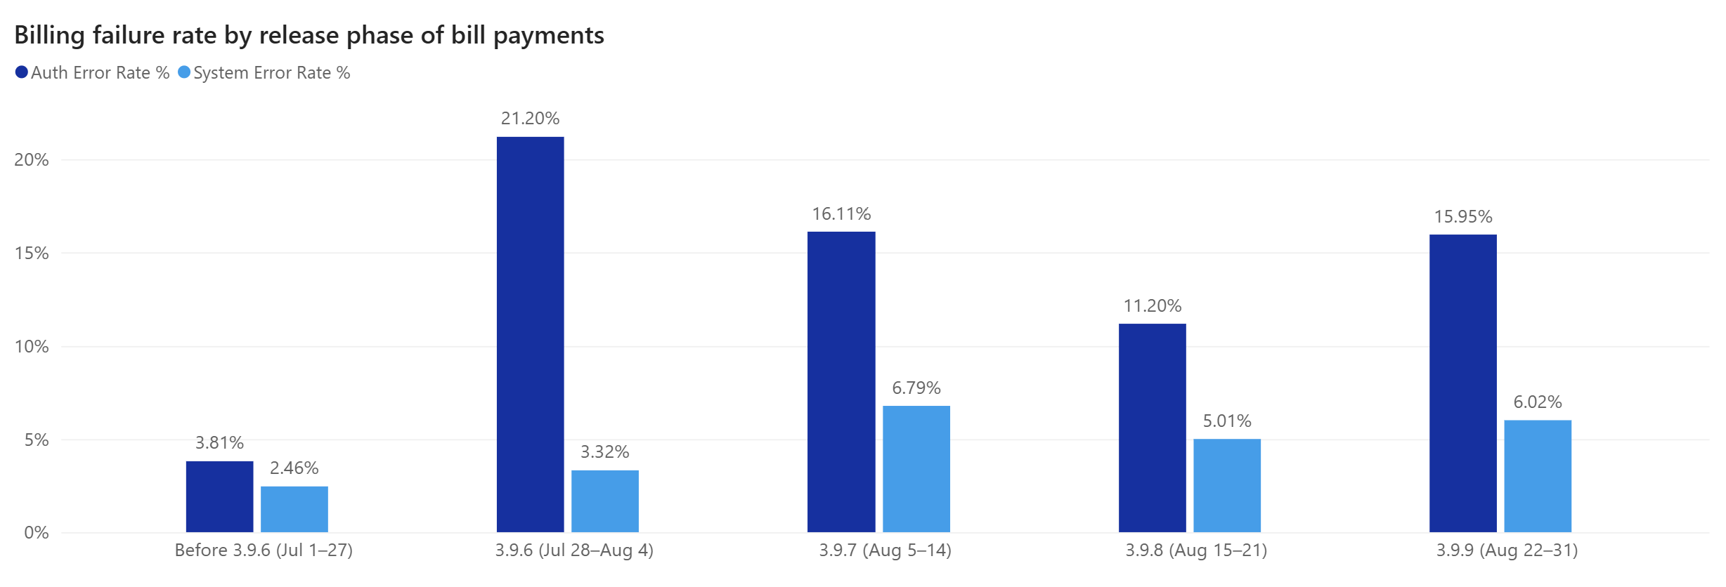
Auth errors peaked with 3.9.6, system errors with API v3.0; no release fixed them
INSIGHT
3.9.6 (release notes: new security checks): auth errors jumped 3.8% → 21.2%, mostly 3DS time-outs. 3.9.7 (gateway API v3.0): system errors doubled 3.3% → 6.8%. 3.9.9 (longer transaction time-outs): auth errors rose again 11.2% → 16.0%.
Notes:
None of the later releases fixed it. v3.9.7 moved to gateway API v3.0 and system errors doubled (3.3% to 6.8%). v3.9.9 raised transaction time-outs, but the OTP/3DS cut-offs look unchanged in the data (still no OTP success above 30 s), and auth errors rose again (11.2% to 16.0%).
Deeper look: (1) Traffic test: daily bill volume and daily success rate are barely related after Jul 28 (r = 0.15); the 10 busiest days (about 139 bills a day) had 72.9% success vs 74.2% on the 10 quietest (about 101). Every hour band fell to 69-74%. Capacity problems usually show up at peak hours and on busy days; this one does not. Caveat: bill volume doubled on the same day (60 -> 116 a day), so a load effect cannot be fully separated from the release effect with this data. Server load and p95 authentication latency would settle it. (2) Phase view: Before 89.9%, 3.9.6 live 71.3%, 3.9.7 live 71.0%, 3.9.8 live 77.3%, 3.9.9 live 72.7%. The best phase is still 12.6 pp below the old level. Only the 3.9.8 phase improved (about +6 pp; z = 3.1 vs the 3.9.7 phase, 2.3 vs the 3.9.9 phase). Its release notes list a redesigned payment flow and queue management for high-traffic periods, which is a lead for what helped; it is not proof, because the phases are short and other changes overlap. Load check: bills per day were 139 in the 3.9.6 phase and about 110 in the later phases, yet the success rate was the same in the first two phases (71.3% and 71.0%). (3) Security-check test: the 3.9.6 notes say face ID is for high-value payments, but every amount band fell (under $100: -16.5 pp, $100-200: -12.1, $200-300: -20.4, $300-400: -21.3, $400-500: -21.1) and fraud blocks went down (0.62% -> 0.49%). The checks themselves are unlikely to block good users; a slower server-side authentication step is the better fit. (4) Limits: release dates match the metric moves, but release notes are not deploy logs. To confirm, compare p95 authentication latency and the server deploys of Jul 28. A rollback test would prove it. Hypotheses: H1 (API time-outs increase at peak traffic) not supported: no peak-hour or busy-day effect; API time-outs did rise after the releases, which belongs to H8. H8 (payment gateway downtime or errors) partly supported: system errors (backend, infrastructure, gateway, integration) rose after release 3.9.7, which moved to gateway API v3.0 (3.3% -> 6.8%), and stayed high (5.0-6.0%), but they explain only about 17% of the rise. Inside them, the rise at 3.9.7 is spread over backend (+0.9 pp), infrastructure (+1.3 pp), integration (+1.0 pp) and the gateway's own errors (+0.3 pp; these grew later: 0.9% before, 2.0% in the 3.9.8 phase). Release 3.9.7 also updated bill-verification integrations and refactored payment logic, so the data cannot say that the gateway API alone caused it.

Slide 9
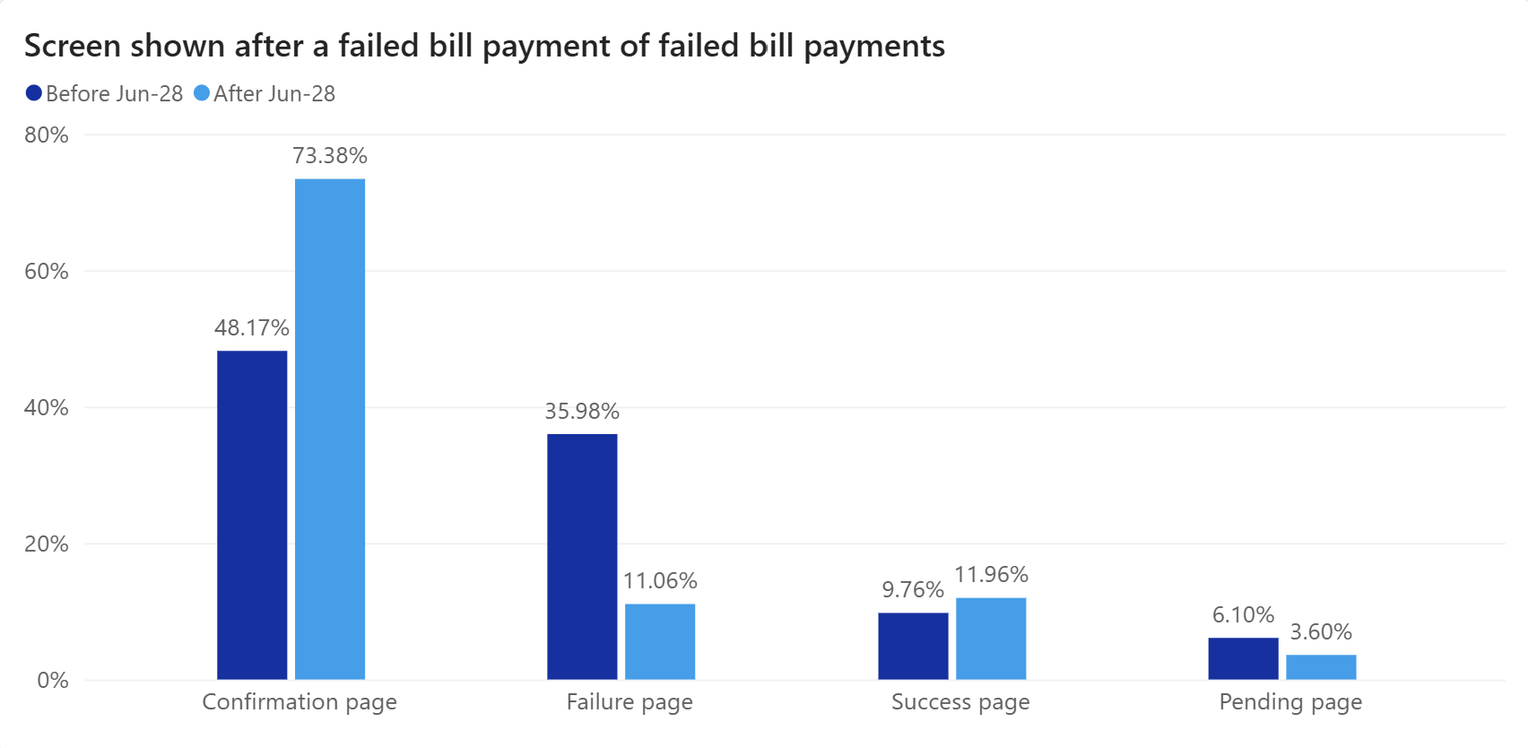
Most failed bills are lost, and users rarely see a clear failure screen
INSIGHT
Only 4% of failed bills were paid again within 7 days (same user, same bill). After Jul 28 only 11% reached the “failure” screen (36% before); 73% ended on “confirmation”, 12% on “success”, 4% on “pending”.
Notes:
Only 4% of failed bill payments were paid again within 7 days. After Jul 28, 73% of failed bills ended on a confirmation screen, 12% on a success screen, 4% on a pending screen and only 11.1% on the failure screen (36.0% before). Impact: about 701 extra failed bill payments in 5 weeks (about 20 a day), about $166K at the average failed bill of $236.
Deeper look: (1) The screen depends on the error. Of the 557 time-out and expired-OTP failures, 550 (99%) ended on the confirmation screen. The 173 failures caused by server, gateway or bank time-outs and errors (backend failures, infrastructure, gateway time-out, bank time-out) never showed a failure screen: 133 (77%) showed 'success' and 40 (23%) 'pending'. The failure screen only appears for clear rejections such as a wrong OTP, a limit or the user leaving. Merchant payments that fail still show the failure screen 43% of the time (51% before). (2) The confirmation-screen event is logged 2-5 s after the payment status event, so it is a result screen shown after the outcome, not the review step before paying. (3) Re-pay rate: 4.0% after vs 4.3% before. Users who saw the failure screen paid again 3.3% of the time (n = 123) vs 4.3% for those on confirmation or success (n = 949), no real difference (z = -0.6): a clear message alone will not recover the bill, it needs a 1-tap retry or an automatic retry. (4) Reach: 773 of 1,411 bill users (55%) had at least one failed bill after Jul 28; in a same-length window the share was 49.5% vs 15.3% in July. (5) No churn signal yet: 97.5% of users with a failed bill made another transaction within 14 days (97.0% after a success). The cost is lost bill payments and trust, and longer-term churn is outside this data. (6) Data note: result-screen events exist for every failed bill but only for 15% of successful bills, so screens are compared among failed bills only. Late fees, support tickets and fee revenue are possible costs and are not measured here. Hypothesis: H4 (users wait for feedback or drop off) partly supported: users get little feedback when a payment fails and rarely try again, which makes the damage worse, but a hard-to-use screen is not shown to be what started the drop.

Slide 10
Fix the bill payment authentication step first
RECOMMENDATION
 | Insight | Recommendation
1 | Billing fell on Jul 28 for old and new apps alike → most likely a server-side change. About 70% of outages come from changes (Google SRE). | Roll back the Jul 28 server changes to the bill payment flow. Re-launch them step by step (5% → 25% → 100% of users) with auto-rollback if bill success rate drops 3 pp.
2 | No OTP succeeds after 30 s, almost no 3DS after 25 s. Slow: 3.8% of OTP and 11.1% of 3DS payments. 2+ tries never succeed (0 of 726). Time-outs and expired OTPs are 69% of the rise. | Find why the step got slower, then extend the limits: OTP 30 s → 3 min, 3DS wait → 5 min (EMV 3DS SDK minimum is 5 min; OWASP ASVS: OTP codes expire after 10 min). Add a countdown, check why retries never work, and test on 5% of users first.
3 | Release v3.9.7 (Aug 5, gateway API v3.0 and other backend changes) doubled system errors (3.3% → 6.8%); 3.9.9 did not fix it. 173 failed bills were server, gateway or bank errors. | Add auto-retry with a fallback route for gateway time-outs, using an idempotency key so a retry never charges twice. Review the v3.9.7 changes (API v3.0 settings, integrations) with the gateway partner.
4 | Only 11% of failed bills show a “failure” screen: time-outs end on “confirmation”, server errors on “success” or “pending”. Only 4% are paid later (≈$166K of extra failed bills). | Show a clear “Payment failed” screen for every failed bill with the reason and a “Try again” button. Show “success” only after the server confirms. Send a push/SMS: “Your bill was not paid” with a 1-tap retry.
5 | The drop ran for 5 weeks (Jul 28 – Aug 31) across 3 fix releases. Daily totals hid it: successful bills per day still rose. | Add a real-time alert: page the on-call team when the last 100 bill payments fall below 80% success (backtest: fires on Jul 28 at 15:53, no false alarm in July). File time-out errors under a system group, not “user factors”.
Notes:
Five actions, in the order of an incident: stop the damage (1), fix the cause (2, 3), make failures visible and recoverable (4), detect earlier (5). Goal: back to the 89.9% baseline, about 20 more paid bills per day.
How big is each lever? Time-outs and expired OTPs are 557 of the 1,112 failed bills after Jul 28 (50%) and 69% of the rise, so action 2 is the biggest. Server, gateway and bank time-outs and errors are 173 failed bills (16%) and system errors are about 17% of the rise, so action 3 is second. These are upper bounds: we cannot know how many slow payments would succeed with a longer limit, which is why the change should be tested on a small share of users first. Industry notes: (1) Google SRE book: roughly 70% of outages are due to changes in a live system; best practice is progressive rollouts, quick detection and safe rollback. The SRE Workbook describes canarying as a partial, time-limited deployment that is evaluated against the rest of the service, with rollback when the canary's error rate is too far from the control. (2) EMV 3DS SDK: challenge time-out of at least 5 minutes. OWASP ASVS V2.7.2 (NIST ref. 5.1.3.2): out-of-band codes expire after 10 minutes. (3) Stripe: idempotency keys allow retries without performing the same operation twice. (4) Show 'success' only after the server confirms; an unknown outcome should be shown as pending and checked again. (5) The alert rule (last 100 bill payments below 80%) fired on Jul 28 at 15:53 in a backtest and raised no false alarm in July. Google SRE book: monitor symptoms (what is broken) and causes (why). (6) Taxonomy: file 3ds_timeout and otp_expired under a system or authentication-service group so the alert goes to engineering, not to user education.

